Slide 1

Foundations of Data Science
Python Programming
Homework Assignment 1
Jaejin Lee
(TAs: Wookeun Jung, Heehoon Kim, Jinpyo Kim)
Due: 11:59PM, Sunday, June 27, 2021
SNU Graduate School of Data Science

Slide 2
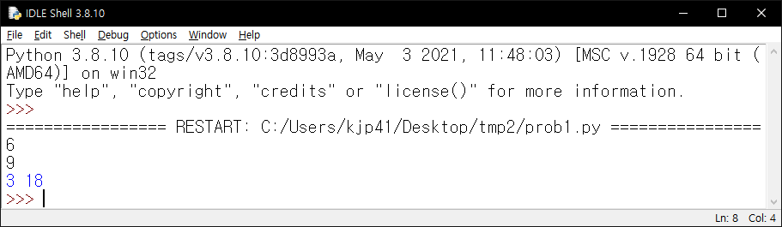
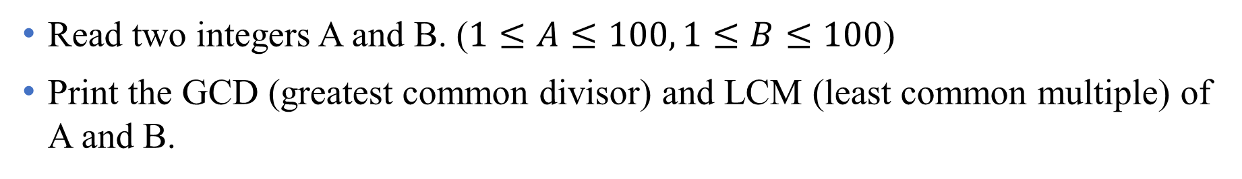
Problem 1
Read two integers A and B. ($1≤A≤100, 1≤B≤100$)
Print the GCD (greatest common divisor) and LCM (least common multiple) of A and B.

Slide 3
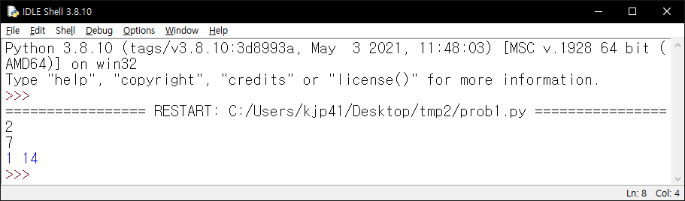
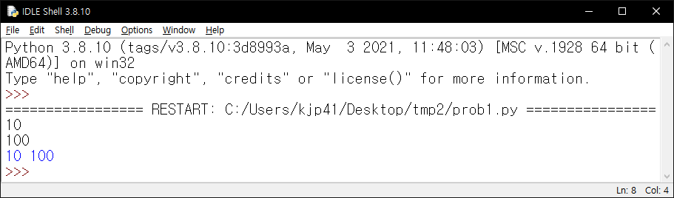
Problem 1
Sample runs

Slide 4
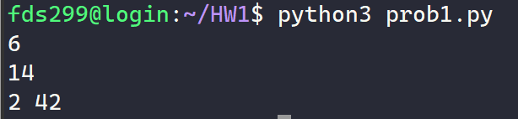
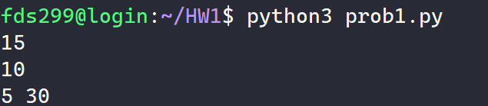
Problem 1
Sample runs
input
output
input
output

Slide 5
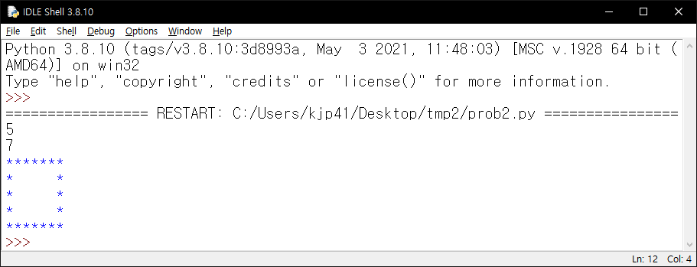
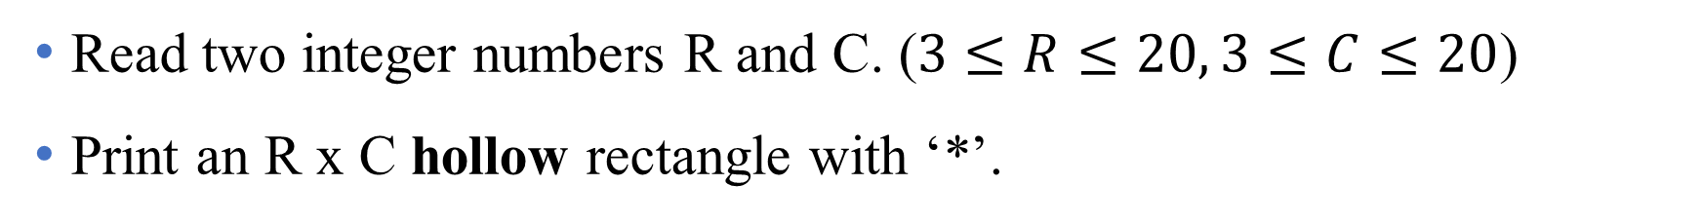
Problem 2
Read two integer numbers R and C. ($3≤R≤20, 3≤C≤20$)
Print an R x C hollow rectangle with ‘*’.

Slide 6
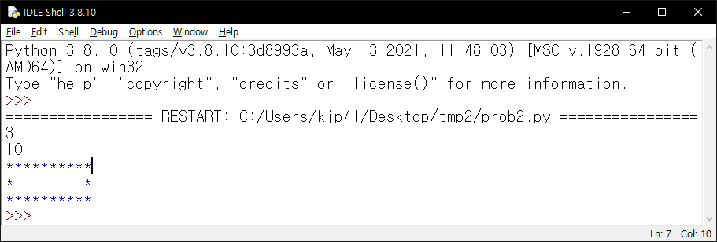
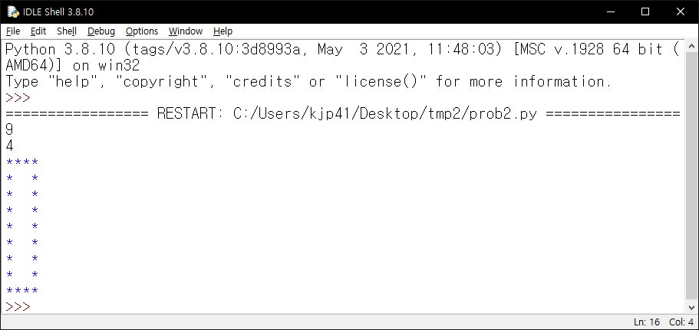
Problem 2
Sample runs

Slide 7
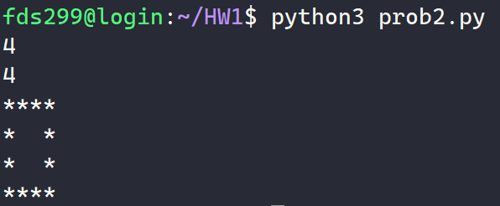
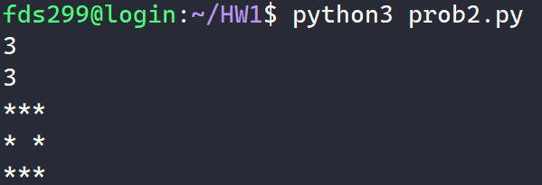
Problem 2
Sample runs
input
output
input
output

Slide 8
Constraints
Use Python 3.x (not Python 2)
Libraries are not allowed.
  Don’t use import keyword.

Slide 9
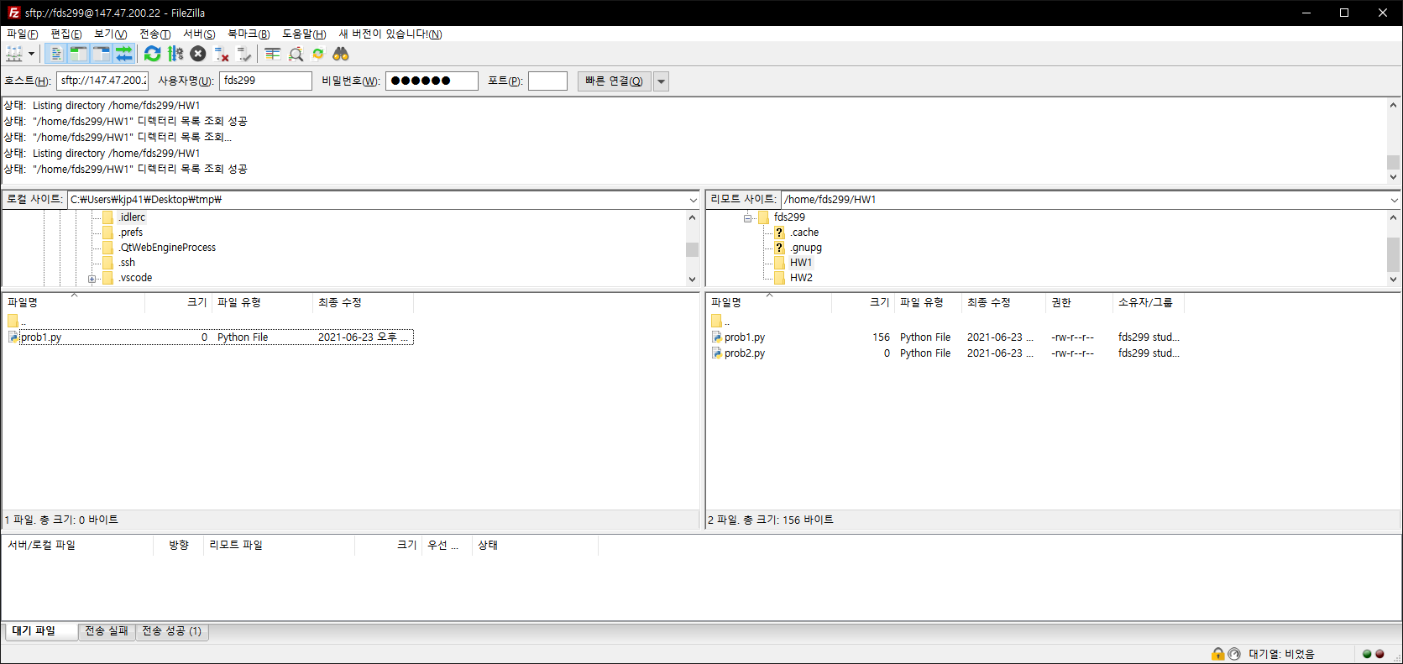
Homework submission
Submission directory: /home/fdsXXX/HW1
  ex. /home/fds299/HW1
Two files: prob1.py, prob2.py

Slide 10
Homework submission checklist
Do not expect TAs will correct your mistake.
Check the submission directory.
Check the name of the submission files.
Make sure the program prints only the required output.
Make sure your debugging code is removed.

Slide 11
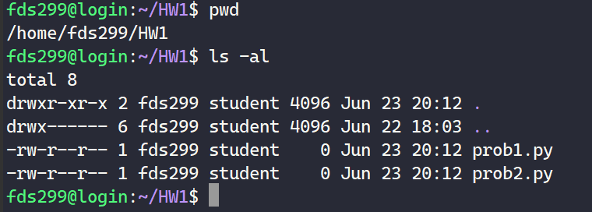
Homework submission checklist
Method 1

Slide 12
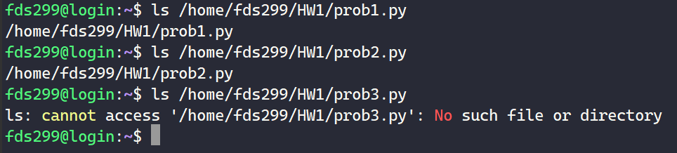
Homework submission checklist
Method 2

Slide 13
Common mistakes 1
Submission file is in a wrong directory.
  [O] /home/fds299/HW1
  [X] /home/fds299/HW_1
  [X] /home/fds299/hw1
  [X] /home/fds299/hw
  [X] /home/fds299/homework1
  [X] /home/fds299/assignment
  [X] /home/fds299/Hw1
  [X] /home/fds299/hw1/hw1
  [X] /home/fds299/1
  [X] /home/fds299/A
  [X] /home/fds299/HW_A

Slide 14
Common mistakes 2
Submission file has a wrong name.
  [O] /home/fds299/HW1/prob1.py
  [X] /home/fds299/HW1/probA.py
  [X] /home/fds299/HW1/Prob1.py
  [X] /home/fds299/HW1/prob1.ipynb
  [X] /home/fds299/HW1/prob1.txt
  [X] /home/fds299/HW1/porb1.py
  [X] /home/fds299/HW1/PROB1.py
  [X] /home/fds299/HW1/p1.py
  [X] /home/fds299/HW1/1.py
  [X] /home/fds299/HW1/A.py
  [X] /home/fds299/HW1/prob_1.py

Slide 15
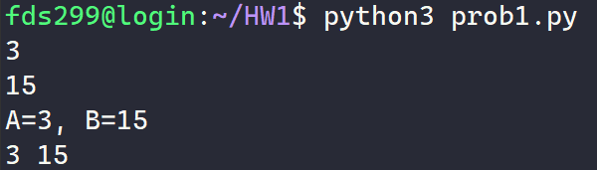
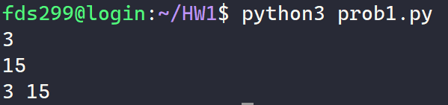
Common mistakes 3
Unexpected outputs (prints).
Debugging code has not been removed.
??
Correct
Wrong

