Slide 1

Foundations of Data Science
Python Programming II
Practice 03
Jaejin Lee (TA: Jinpyo Kim)
SNU Graduate School of Data Science

Slide 2
Homework submission
Write your program on local machine, then upload the files to the server.
or
Write your program directly on the remote server.
  Do not modify the source code after deadline.

Slide 3
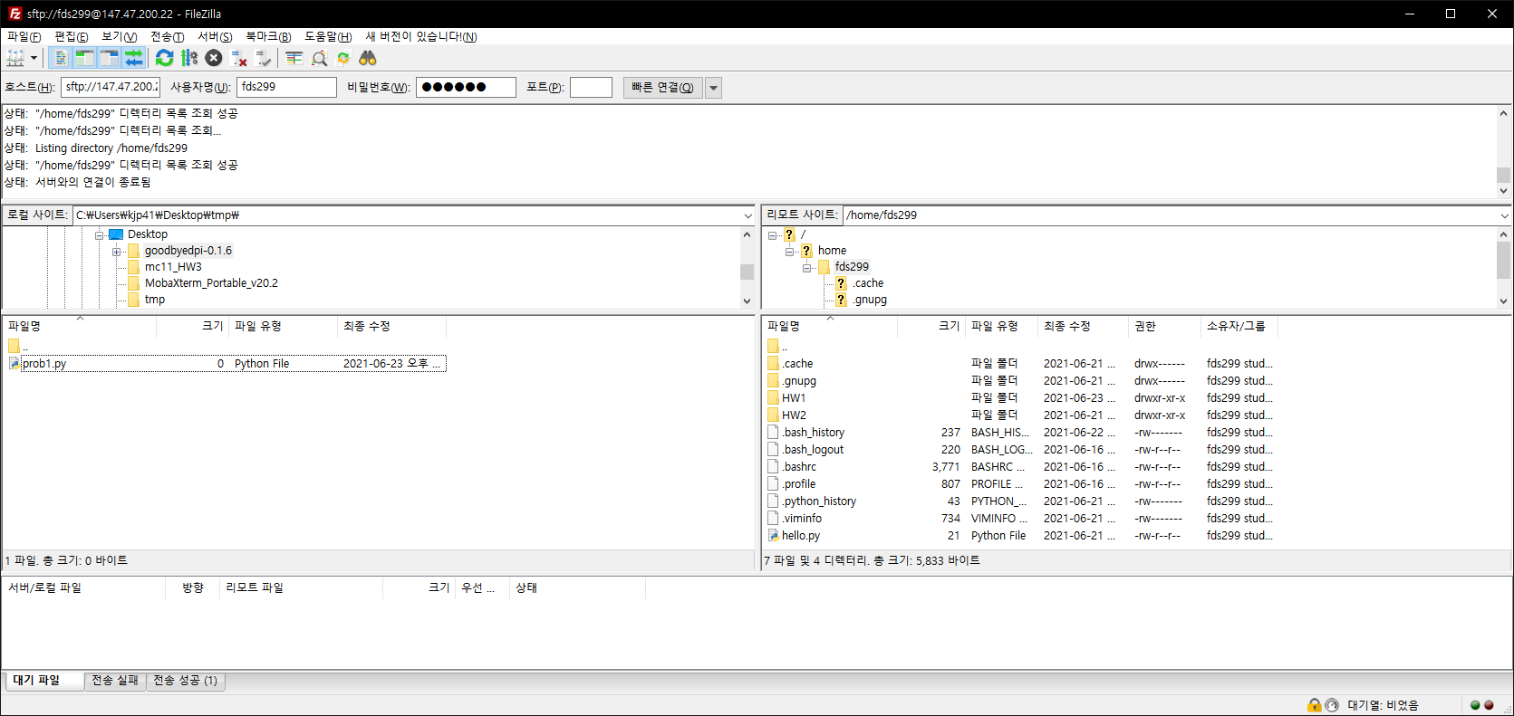
FileZilla
Program to move files between local and remote server.

Slide 4
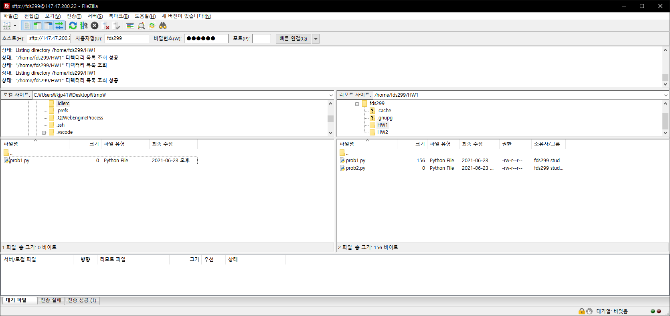
Homework submission
Submission directory: /home/fdsXXX/HW1
  ex. /home/fds299/HW1
Two files: prob1.py, prob2.py

Slide 5
Homework submission checklist
Do not expect TAs will correct your mistake.
Check the submission directory.
Check the name of the submission files.
Make sure the program prints only the required output.
Make sure your debugging code is removed.

Slide 6
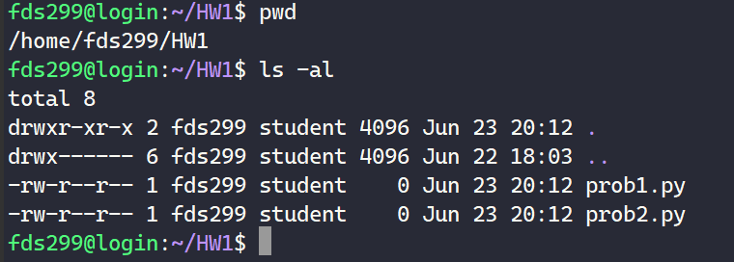
Homework submission checklist
Method 1

Slide 7
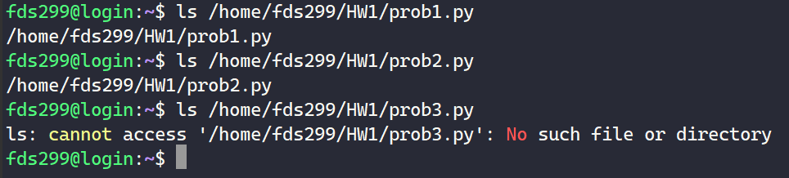
Homework submission checklist
Method 2

Slide 8
Common mistakes 1
Submission file is in a wrong directory.
  [O] /home/fds299/HW1
  [X] /home/fds299/HW_1
  [X] /home/fds299/hw1
  [X] /home/fds299/hw
  [X] /home/fds299/homework1
  [X] /home/fds299/assignment
  [X] /home/fds299/Hw1
  [X] /home/fds299/hw1/hw1
  [X] /home/fds299/1
  [X] /home/fds299/A
  [X] /home/fds299/HW_A

Slide 9
Common mistakes 2
Submission file has a wrong name.
  [O] /home/fds299/HW1/prob1.py
  [X] /home/fds299/HW1/probA.py
  [X] /home/fds299/HW1/Prob1.py
  [X] /home/fds299/HW1/prob1.txt
  [X] /home/fds299/HW1/prob1.ipynb
  [X] /home/fds299/HW1/porb1.py
  [X] /home/fds299/HW1/PROB1.py
  [X] /home/fds299/HW1/p1.py
  [X] /home/fds299/HW1/1.py
  [X] /home/fds299/HW1/A.py
  [X] /home/fds299/HW1/prob_1.py

Slide 10
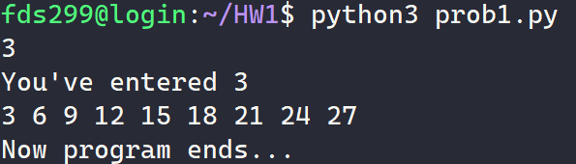
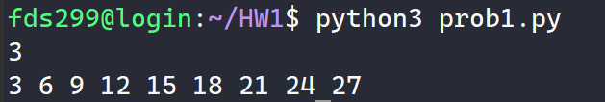
Common mistakes 3
Debugging code has not been removed
??
Correct
??
Wrong

Slide 11
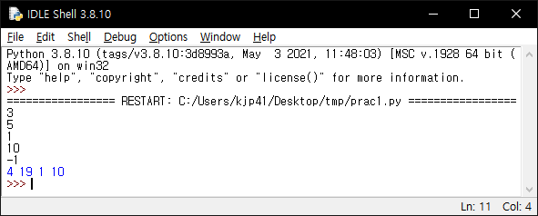
Problem 1
Read integers until -1 comes in.
Print count, sum, maximum, minimum of the integers.

Slide 12
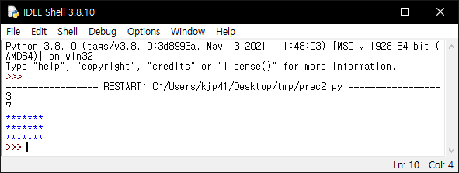
Problem 2
Read two integers R and C.
Print an R x C rectangle with ‘*’.

Slide 13
Q&A

